Slide 1
xBGAS Group Meeting
Xi Wang
10.19.2017

Slide 2
Updates:
Create a separate branch named “Xi”
Review the OHPC work related to the compiler backend and tablegen.
Added the extended registers and instructions to the RISCV-LLVM backend.
Reading the papers related to overhead of conventional inter-node communications.

Slide 3
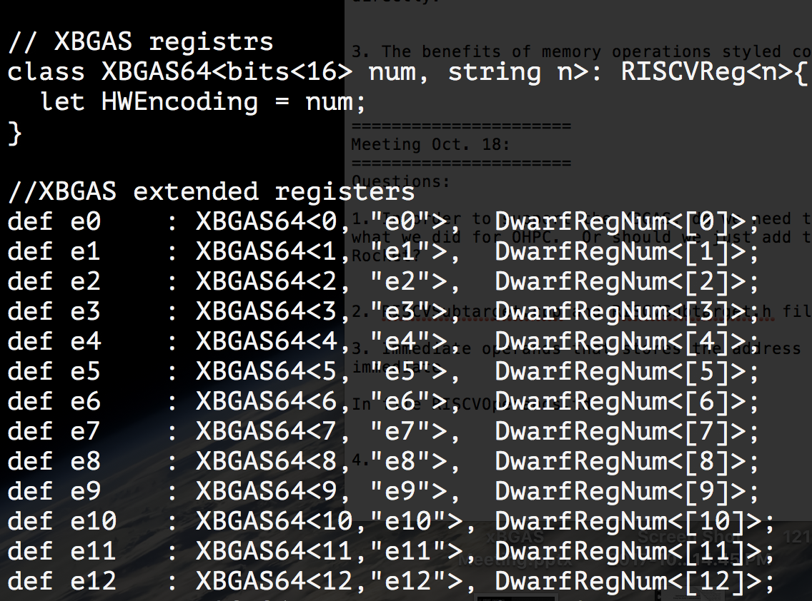
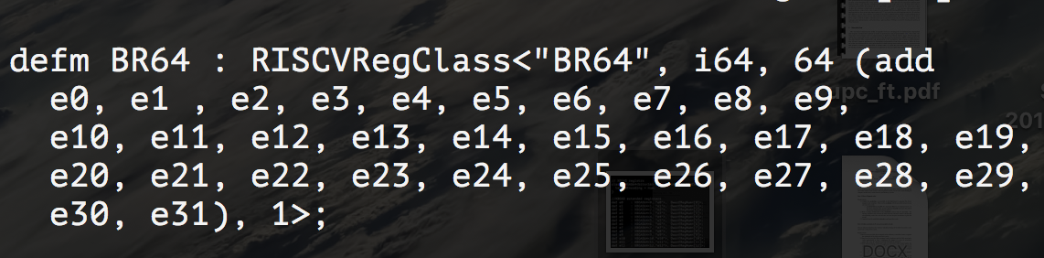
Registers

Slide 4
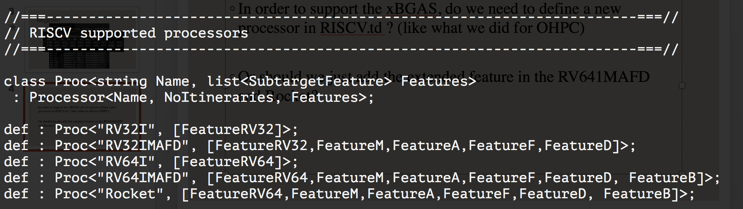
Processor

Slide 5
Question
In order to support the xBGAS, do we need to define a new processor in RISCV.td ? (like what we did for OHPC) Or should we just add the extended feature in the RV641MAFD and Rocket?
In RISCVSubtarget.h and RISCVSubtarget.cpp, as there is no td file with the same name, do we need to manually define the features such as hasB(), hasO()?

Slide 6
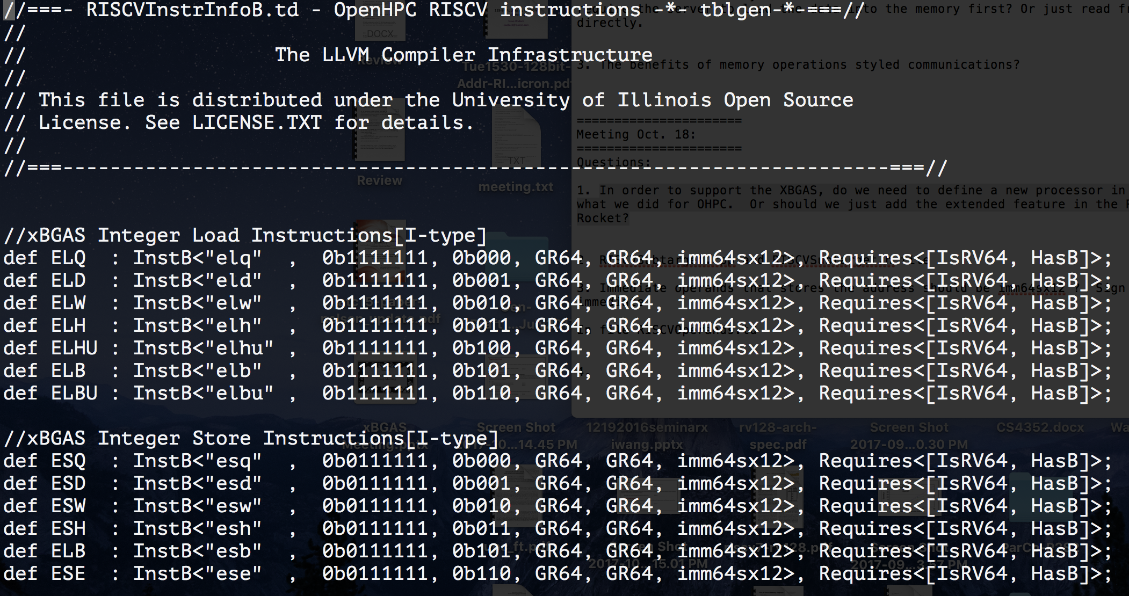
Instructions

Slide 7
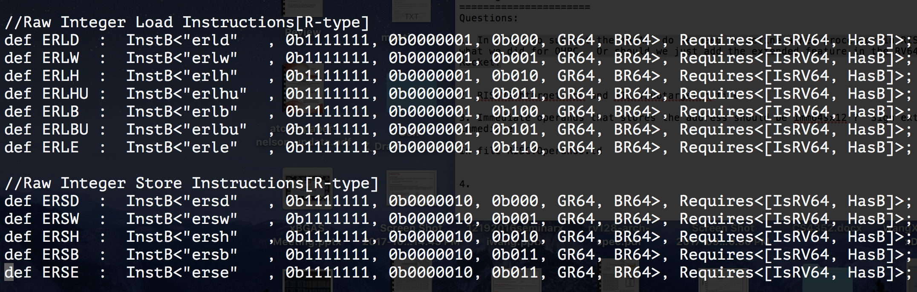
Instructions

Slide 8
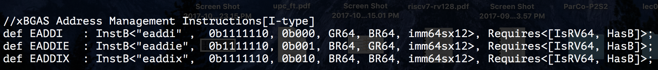
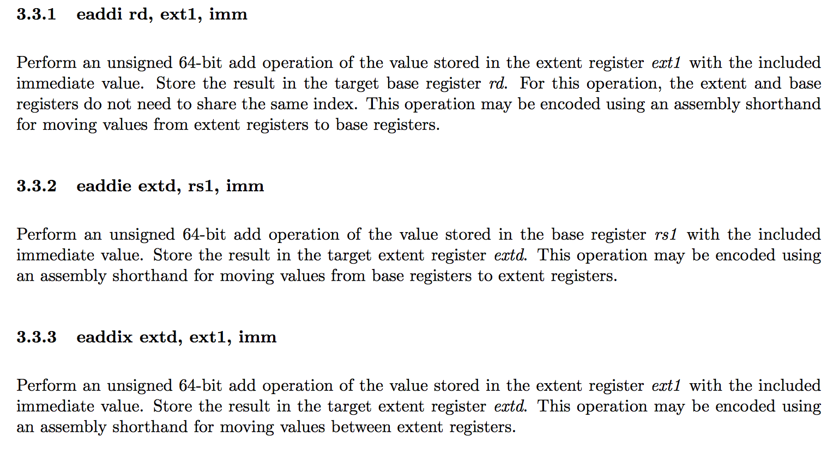
Instructions
Order of the operands?
Imm64sx12? (RISCVOperands.td)

